Slide 1
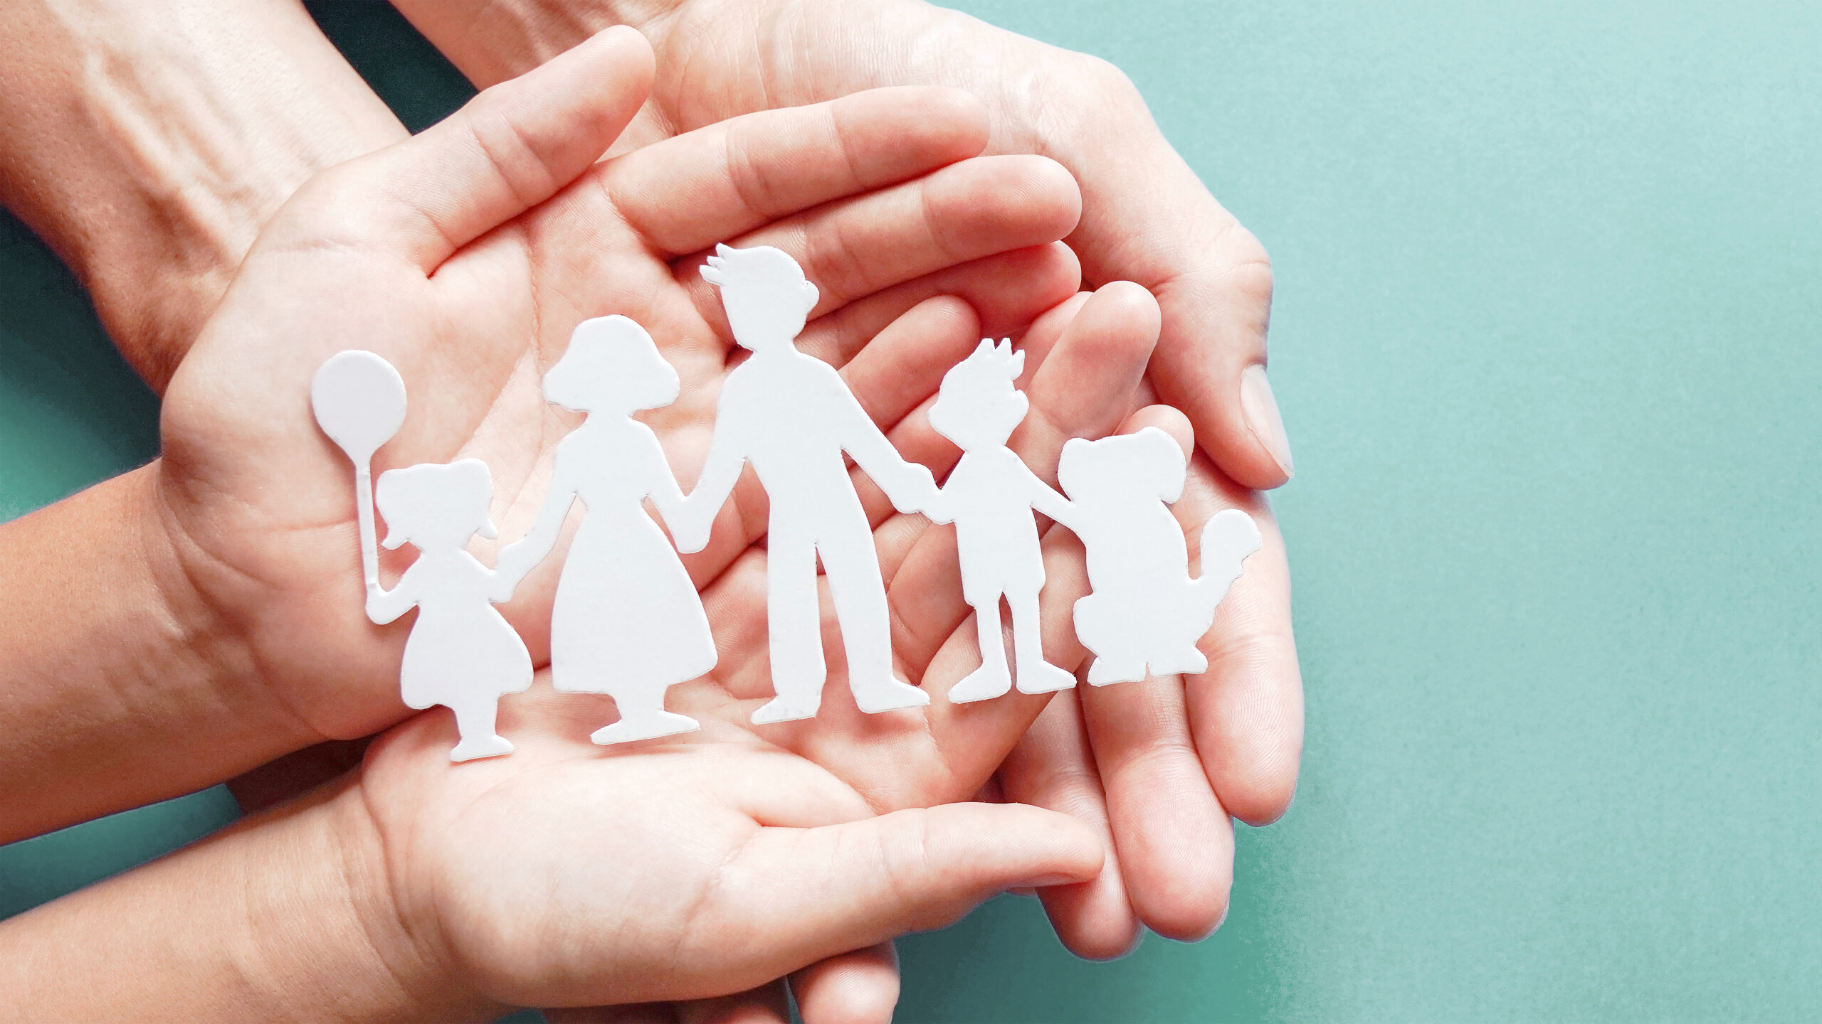
Parents and Youth
Strengthening Communication and Relationships

Slide 2
What helps you feel closer to your family?
God
Spending time together.
Activities/gathering
Hanging out with my family
Spending time with each other
If they actually care about my feelings
Going out
Having conversations all together

Slide 3
Do you feel like it's easy or difficult to talk to your parents/adults about your feelings. Why?
Easy
Kind of awkward because it feels uncomfortable talking about my feelings.
Fairly easy
I think that it is easy to talk to my parents
I feel like with my mom it’s easier because I feel like she understands me better than my dad does just because we don’t go through the same things
Hard because they just don’t pay attention to my needs
I find it difficult because they wouldn’t understand
Easy because I am really open with them!
Difficult because they sometimes misunderstand what I'm trying to say

Slide 4
If you could change one thing about how you and your parents communicate, what would it be?
Nothing
they actually grasp my feelings
A little less yelling
Being more invested
Feeling like I can say things I observe that could be changed
Not getting so heated as quickly
Have them stop yelling at me so often
I feel like I need to be better at being more attentive and ever since I have gotten my phone, I felt less attentive.

Slide 5
What's the best way for your parents to show they're really listening?
Them looking at me
Actually listen put down the phone “mom? mom? mom!!!” “I’m listening!!!” with her nose deep in her phone but when I am listening to her, looking her dead in the eyes just don’t reply when she says my name cuz I’m right here she freaks out
Stop what they are doing for a minute look at me and listen.
Ask or try to understand
They acknowledge what I say
Giving me advice and being honest with me
Stop whatever they are doing and look at me
They are looking at me but not always because if we are in the car they have to pay attention to the road!

Slide 6
When you're having a hard/bad day, what would you like your parents to do? (listen, give space, give advice, etc)
Give space
Spend some one-on-one time with me and give me advice.
Listen, give space, or give advice are all good
I would like them to listen and tell my younger siblings to leave me alone
I like to tell them about it and let me decompress
Talk to them about it and get advice
Leave me alone
My parents would probably talk to me and we might go get a treat as a family or I am might just go with one of my parents!

Slide 7
What is something your parents do that really makes you feel loved and cared for?
hug me, talk to me, pay for me to do stuff, support me in what I do in sports etc
gifts, food, hiking
They take me out to do stuff that I like to do.
Listening or expressing interest
That they are so hard working and they still manage to care for the whole family
They take me to do fun things
When we just get to sit and talk or like go get food together
Space
They always watch me play soccer even when I have a game in north Logan at 5 am!
Always asking how I'm doing

Slide 8
Are there topics that feel hard or uncomfortable to talk about?
Testimony/Faith Struggles
School/Grades
Mental Health ( stress, anxiety, depression)
It can be embarrassing to ask for help or it can feel like you’re a failure if you struggle or have problems especially because you don’t want to upset or let down your parents

Slide 9
What would help you be able to communicate better with your parents?
When I mess up, my parents sit with me and kindly point me in the right direction.
If I knew I would be loved
I don’t really struggle talking to my parents
Not worrying about their reaction
I think we have pretty good communication
It would help if I wasn’t on my phone all the time so it is my fault!

Slide 10
What would help strengthen your relationship with your parents?
Doing stuff they like to do. Getting to know them as people, not just parents.
More conversations
We have pretty good relations ship with each other
Being with more often
We try to go on dates, (me and my parents) but we are busy with all of our siblings doing things.

Slide 11
What gospel principles or topics you like us to teach or talk more about?
The doctrine and covenants understanding where it comes from
Atonement, forgiveness, you’re not in too deep with any sin or addiction
Ordinances and commandments and what they mean
The Second Coming!

Slide 12
What helps you feel welcome and included at church and activities?
people being there and hanging out
friends
I already feel that way.
That we all are such good friends
Activities when we’re with everyone not just our friends
Having people I like there
Talking with all of the girls in my class!

Slide 13
What can your leaders do to help you feel more supported and understood?
I feel supported and understood already.
Start conversation and be a good friend
I don’t need anything
nothing! They are doing amazing
I feel supported and understood! I think my leaders are doing amazing!

Slide 14
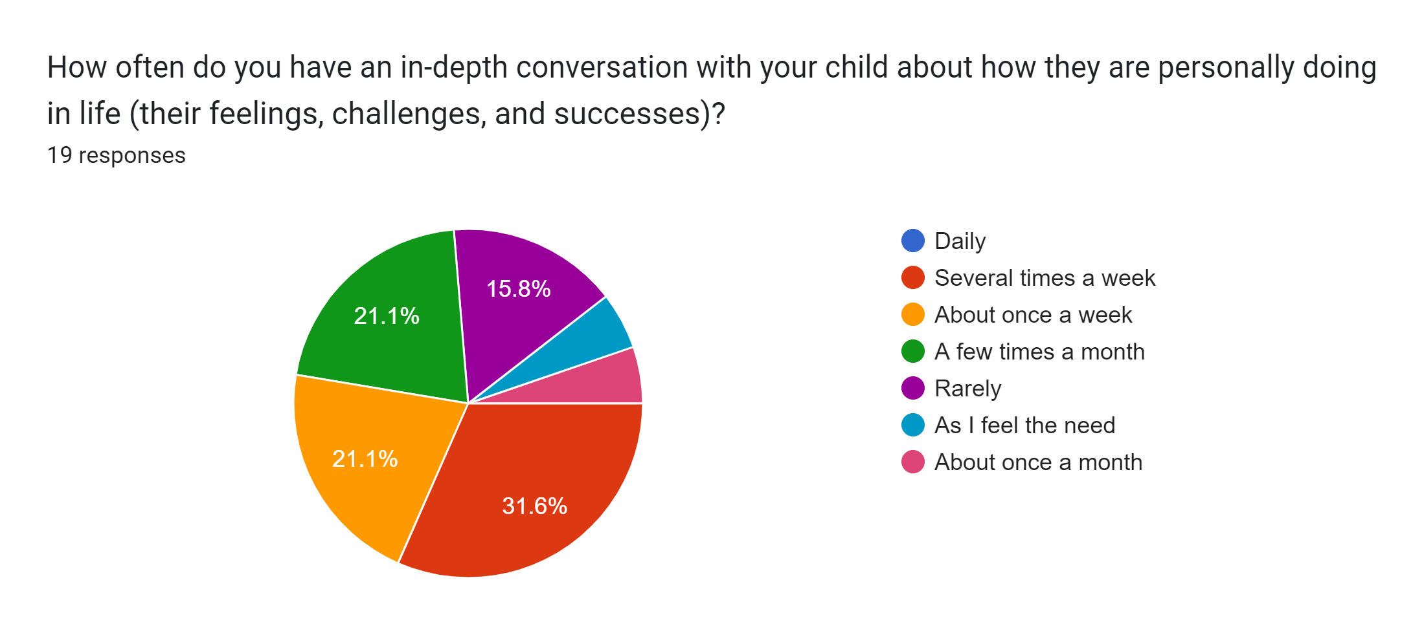

Slide 15
Would you be willing to share any general examples of how having (or not having) these in-depth conversations has influenced your relationship or your child’s well-being?
I think we have a good relationship until we try to have important conversations. I can’t be a good parent if they won’t tell me anything. I don’t think they understand their own feelings.
Because there are multiple children in our family any in depth conversations that we have are always helpful for everyone involved.
Our conversations help me feel more connected to their challenges, and also keep the door open so hopefully they will come to me for advice when needed and without me asking.
Sitting in the moment and listening and acknowledging their feelings; not trying to fix things immediately.
I think they know I am there for them and help them work through different issues.
Talking with my kids in-depth lets them know that I care about them and their life. There have been times I needed to step in to get help for my kids or their friends, that I was able to do because my kids talk to me. I am glad I was able to get help earlier rather than after big things happened.
It’s the only way to create true connection.
I’m not sure any conversations sink in, but I’m going to keep having them. Hopefully one day they will use something from one of our talks.

Slide 16
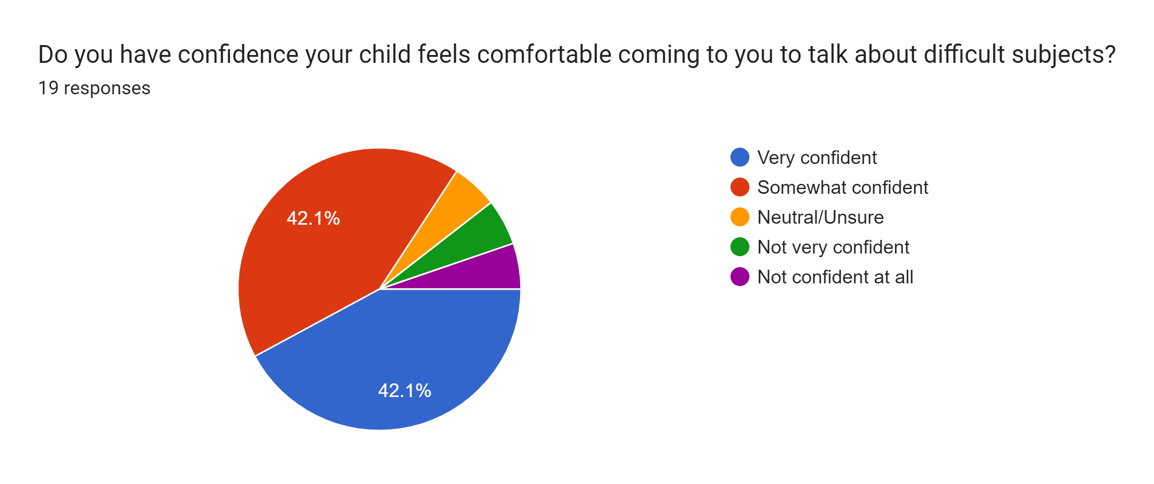

Slide 17
What experiences or approaches have you found helpful—or challenging—in encouraging your child to feel comfortable talking with you about difficult subjects?
We started a book/journal we pass back and forth. It’s been helpful.
We just do it, we just talk about those hard topics and get it over with. It usually ends in a whole other conversation and laughs
I have approached them about concerns or feelings I’ve had about them, even with limited information or observations. Sometimes this has opened the door to a deeper discussion on the subject.
Just being open and honest. Answer questions as they come in rather than deflect or side step the subject.
I try to explain the why behind the conversation and empower my child to have a voice and know that they will be heard.
Listen openly, don’t try to solve problems without asking permission first. Manage my own reactions and fears. Never lecture teens! It is always better to have discussions.
Being real open and honest and talking about the most uncomfortable stuff. Just gotta lean into that discomfort if we want them to keep coming back and talking to us instead of their friends.
I feel like being non-judgemental and knowing that they will make mistakes such as I have, and showing kindness in situations instead of getting angry.

Slide 18
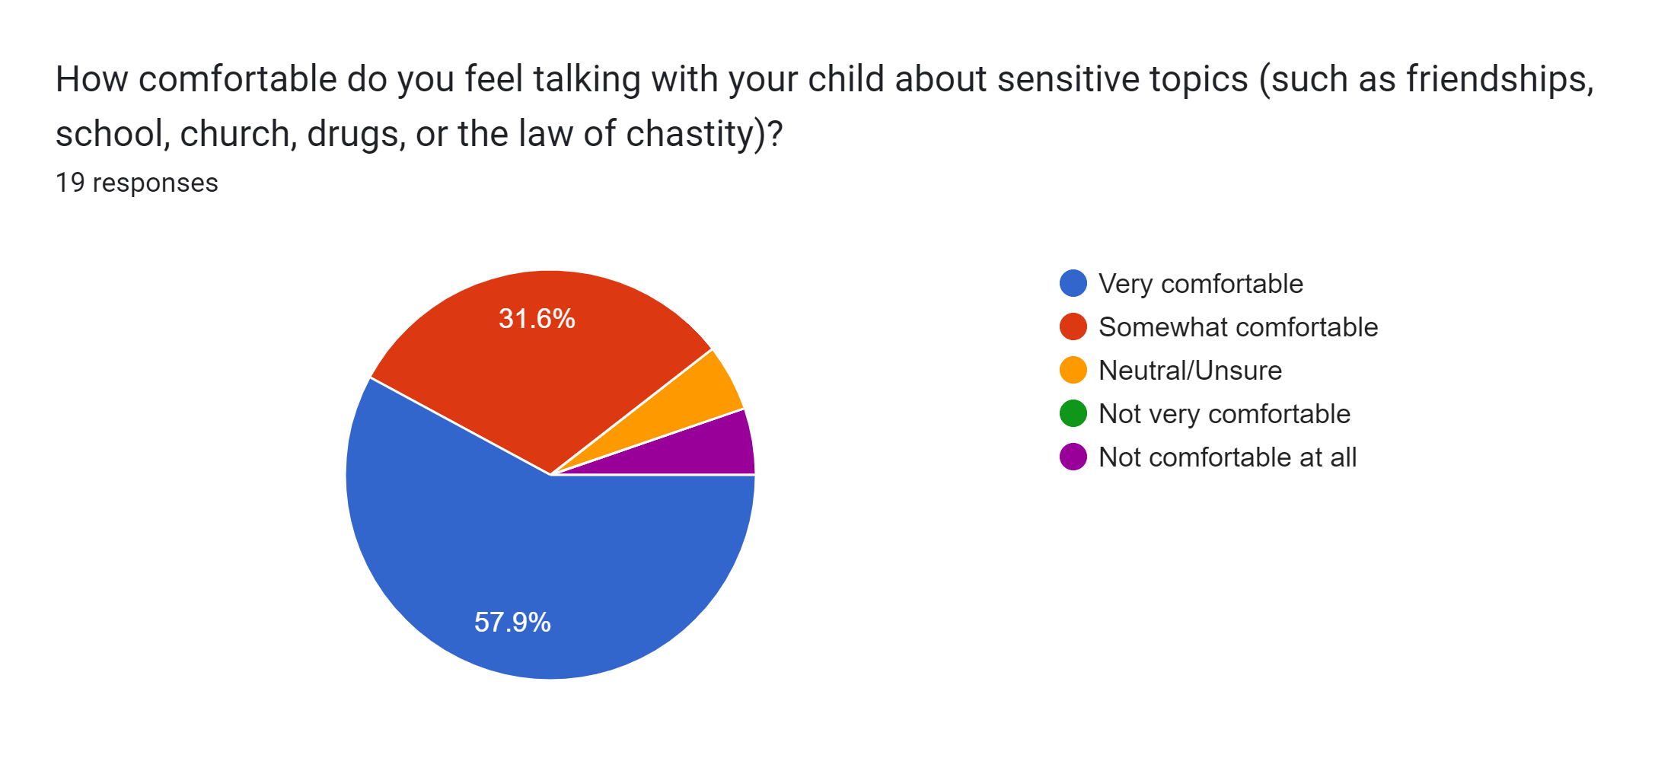

Slide 19
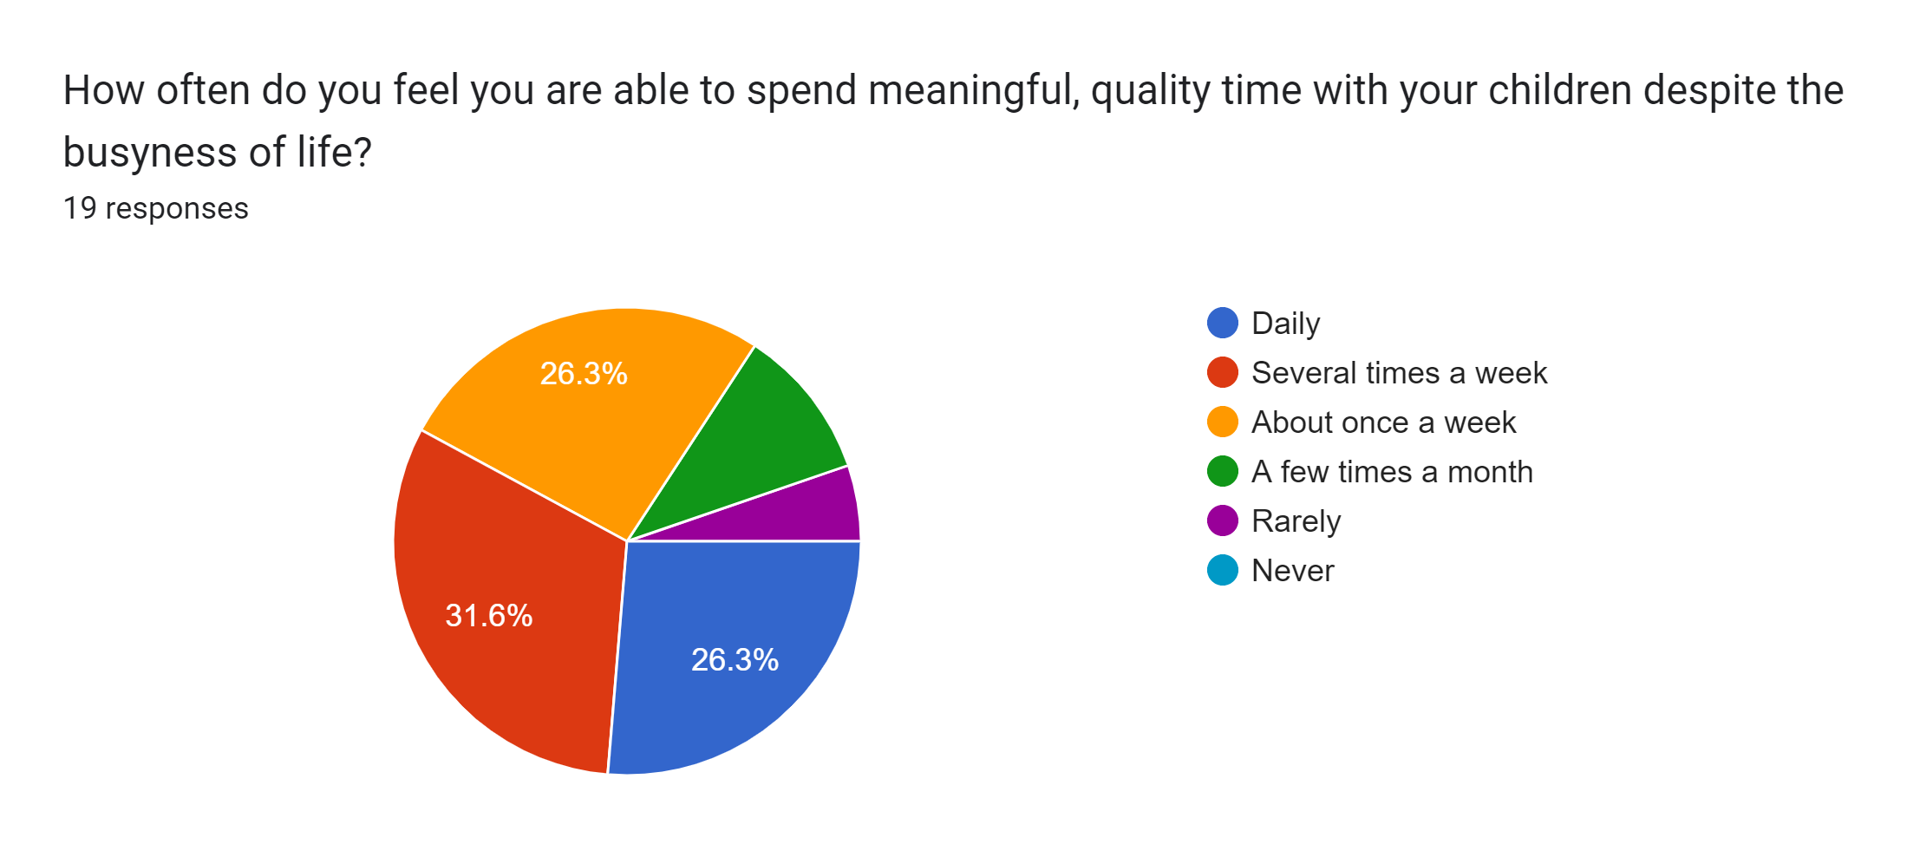

Slide 20
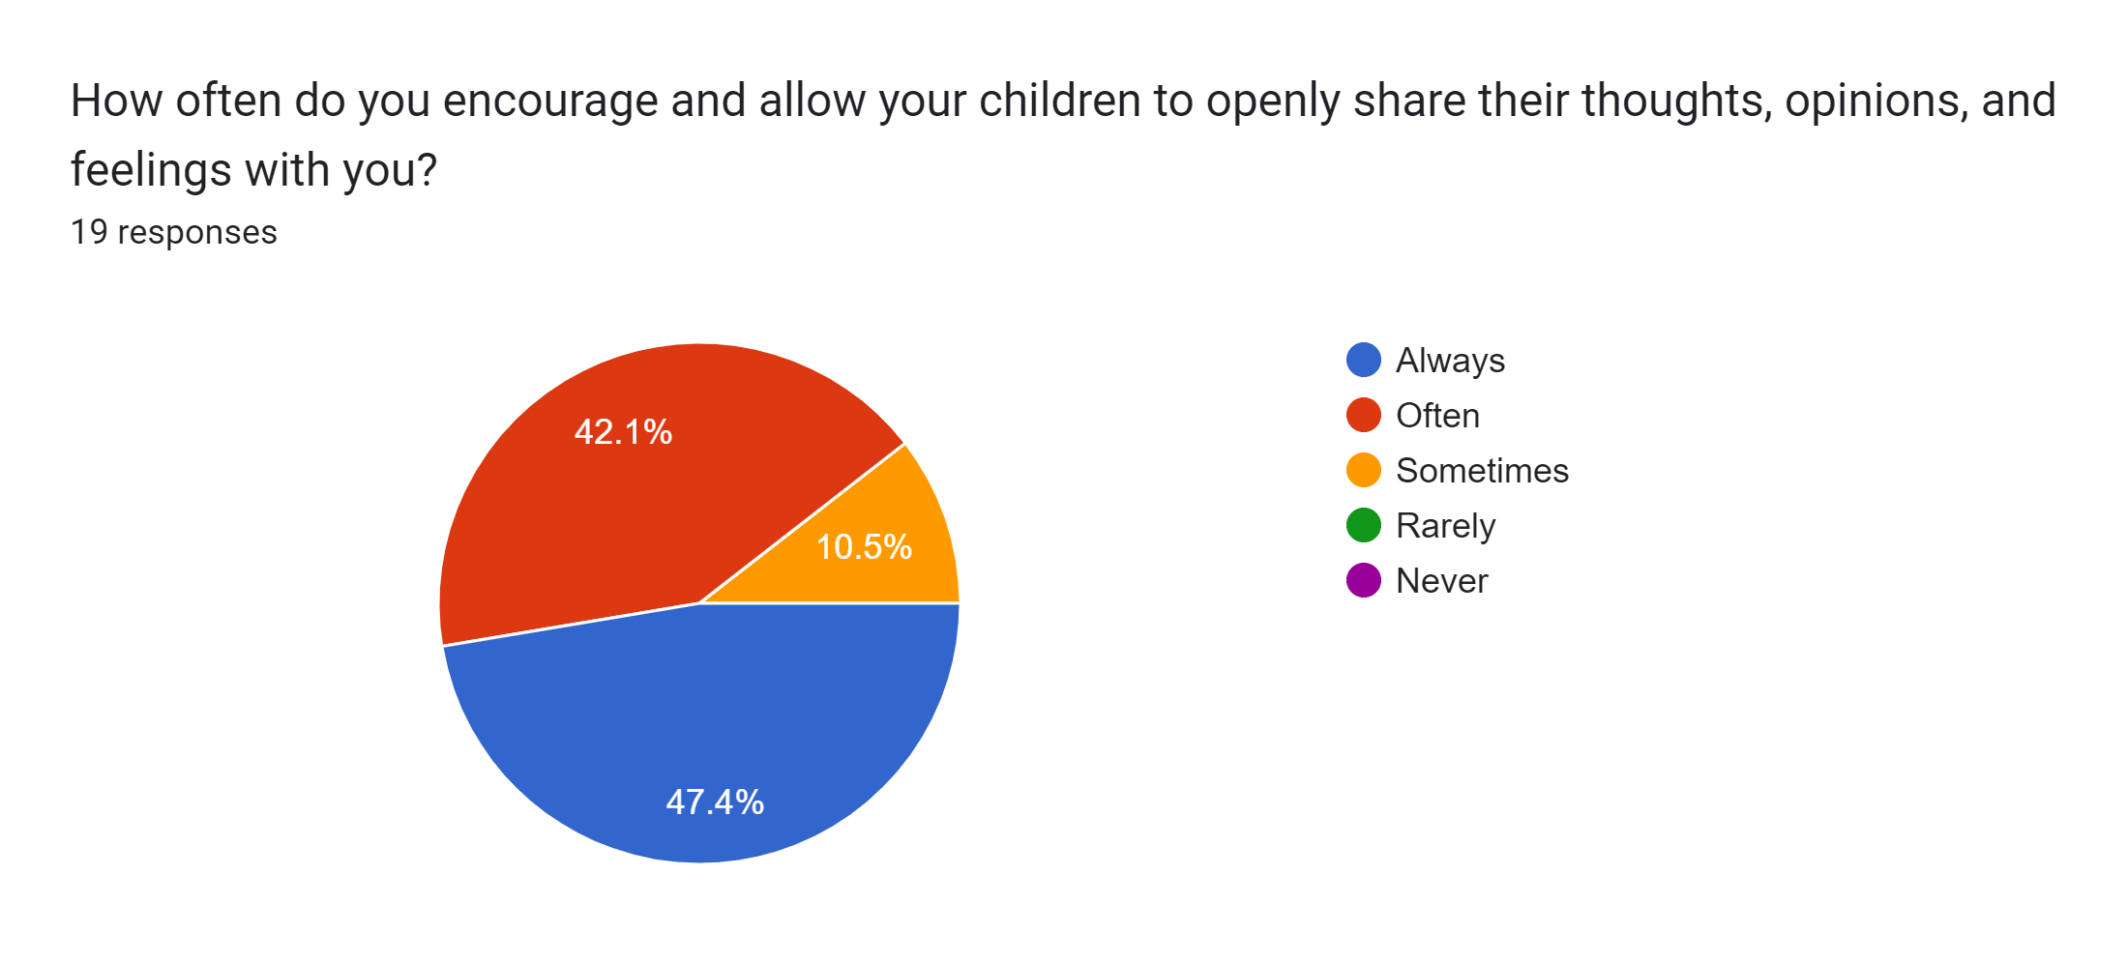

Slide 21
In what ways has encouraging your children to share their thoughts, opinions, and feelings impacted your relationship with them—either positively or with challenges?
It’s a challenge because they won’t open up.
Not the best at this… I’d like to listen more than talk.
Not sure. I hope it means they can come to me with things.
Helps them better regulate their emotions and have more meaningful and deeper conversations with them.
It allows us to have a closer relationship with our children.
When things come up they know that I am a safe space to share. Also explaining that life challenges are to be expected, it’s how we react to them.
I am grateful that my kids are chatty and will talk with me. I feel I have a very good relationship with my kids because of this.
Never freak out. No matter how much I’m screaming inside or want to run or cry or completely lose it, I gotta sit there and talk to them like I’m giving them directions to the grocery store. It’s the only thing that has made us be approachable. Shaming them never helps or works so I really have to choose my words carefully and that is very hard!
I hope just trusting me, and they know they are never alone. Definitely positive.

Slide 22
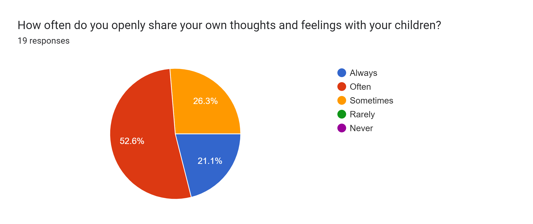

Slide 23
If you are comfortable sharing, what impact have you noticed (positive or challenging) when you openly express your own thoughts and feelings with your children?
I think it’s super important for my kids to know, I know what it’s like to struggle.
When I honestly share my thoughts they understand more than I would give them credit for.
I think it normalizes sharing. If my child sees me do it then they know it’s safe and okay for them to share also.
I think it is important to model appropriate ways to share thoughts and feelings. Using I statements, not blaming the other person, etc. I find that my kids are able to relate to me as a person and not just a parent that is there to meet their every need. I feel this leads to a more respectful relationship. I don’t share everything, I do make sure what I share is appropriate for our relationship and I am not using my kids to vent to. They are not here to meet my needs, I am here as a parent to guide them.
I have also noticed that it has created an atmosphere of sharing for our family culture. As my teens are becoming their own person with their own thoughts and feelings they have a safe place to express themselves without judgement. This helps open up topics of discussion in a way that is more natural and less preachy.
It allows them to know that they don’t have to be perfect either. This expectation is too much and I already know I’m not perfect and mess up all the time but I need to tell them that so why should I expect them to be perfect? It’s ok to have flaws. I’m also careful how I word things because it’s NEVER the child’s job to manage a parent’s emotions. That’s ALL on me. I can share what I’m feeling but I take ownership of that and don’t ever expect them to make me feel better. Sharing my emotion creates a safe space to allow them to share theirs. I can help them manage theirs, but it’s not their job to make sure I’m ok.
Sometimes because we are parents our kids don’t realize that we have made mistakes in our past and we are also human.

Slide 24
https://www.churchofjesuschrist.org
1. Talking with Teens
2. Getting Teens to Talk: Eight Tips for Improved Communication
3. Three Tips for Better Parent-Child Communication

Slide 25
I have learned that the head does not hear anything until the heart has listened, and that what the heart knows today the head will understand tomorrow.
Jones Stephens

